Slide 1
리눅스 스케줄러 기본 구조
국민대학교 임베디드 연구실
경주현
2017 LG MC 인재육성팀 교육

Slide 2
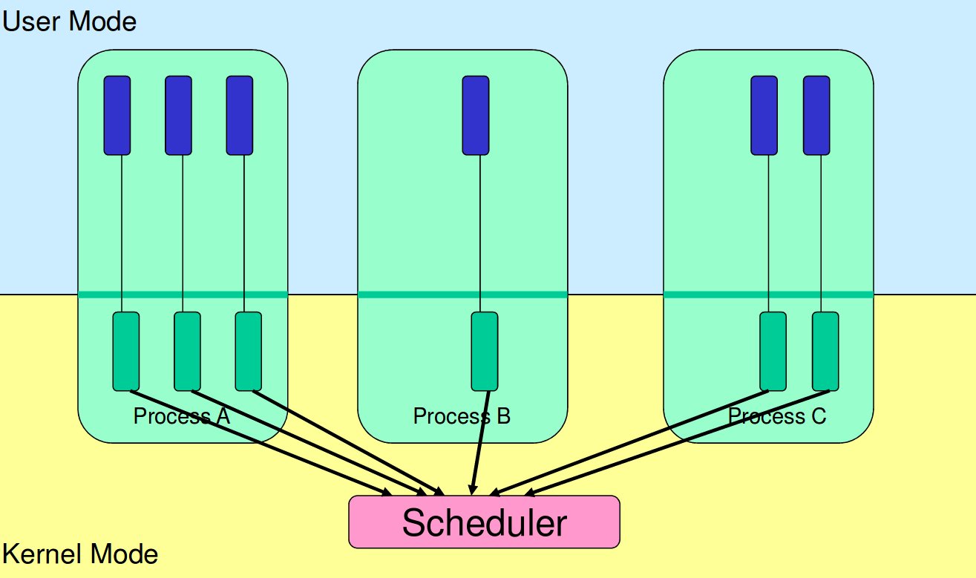
Kernel-level threads

Slide 3
Linux multiplexing
Linux multiplexes by two situations.

Slide 4
Linux multiplexing
Linux multiplexes by two situations.
Sleep and wakeup mechanism
process wait for device or pipe I/O

Slide 5
Linux multiplexing
Linux multiplexes by two situations.
Sleep and wakeup mechanism
process wait for device or pipe I/O
Periodically forces a switch
Preemption
Multiplexing creates the illusion
Each process has its own CPU
Each process has its own memory

Slide 6
Linux scheduler design philosophy
Linux schedules user and kernel threads preemptively.
Every 10ms a timer interrupt -> yield
Except for tick-less status
Complete defense against CPU-hogging user programs, even bugs
Helps with responsiveness
Fairness

Slide 7
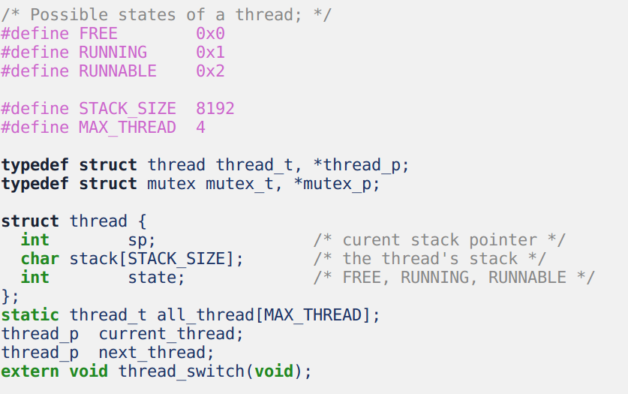
User-level threads - data structure
/home/lkc/userlevel
컴파일
실행

Slide 8
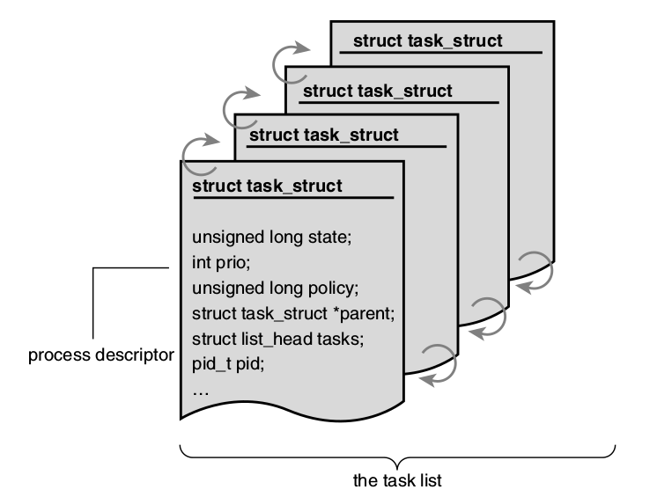
Linux Process Descriptor

Slide 9
Scheduling entity
task_struct is associated with a sched_entity data structure
Scheduling information
load, weight, a group or a single task
A single task becomes a scheduling entity on its own.
struct task_struct { struct sched_entity se; /* ... */ };
struct sched_entity { struct load_weight load; struct sched_entity *parent; struct cfs_rq *cfs_rq; struct cfs_rq *my_rq; struct sched_avg avg; /* ... */ };

Slide 10
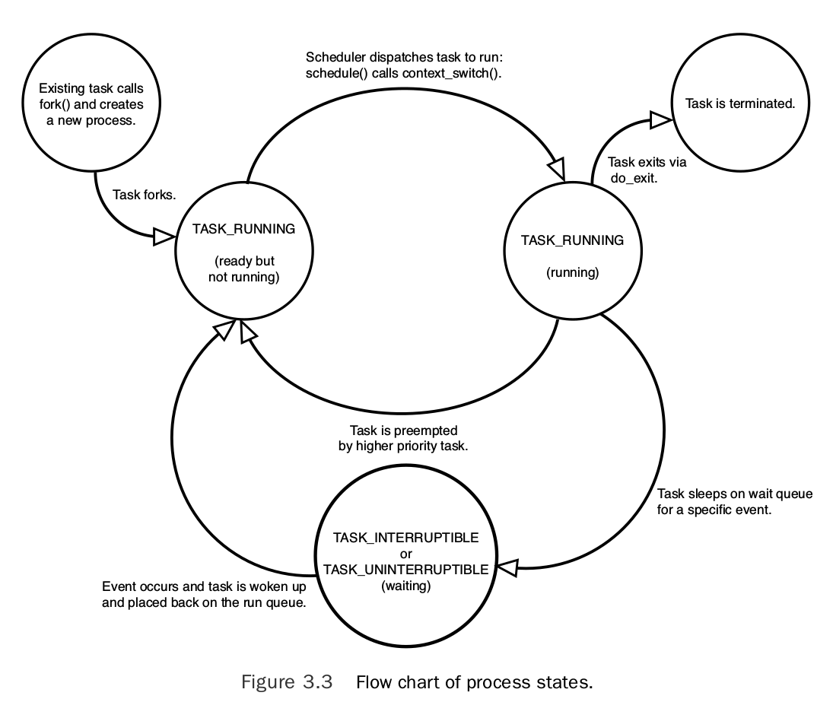
Linux Process States

Slide 11
Sleep & Wake up
Sleep &
Wake up

Slide 12
The schedule()
Ready-to-run processes are maintained on a run queue.
Once the timeslice of a running process is over
Picks up another appropriate process from the run queue.
A process can go to sleep using the schedule() function.
http://www.linuxjournal.com/article/8144?page=0,2

Slide 13
Ex) Go to sleep by schedule()
Store a reference to this process' task structure
Set current state changes from TASK_RUNNING to TASK_INTERRUPTIBLE
The schedule() should schedule another process
sleeping_task = current; //A
set_current_state(TASK_INTERRUPTIBLE); //B
schedule(); //C
func1();
/* The rest of the code */
http://www.linuxjournal.com/article/8144?page=0,2

Slide 14
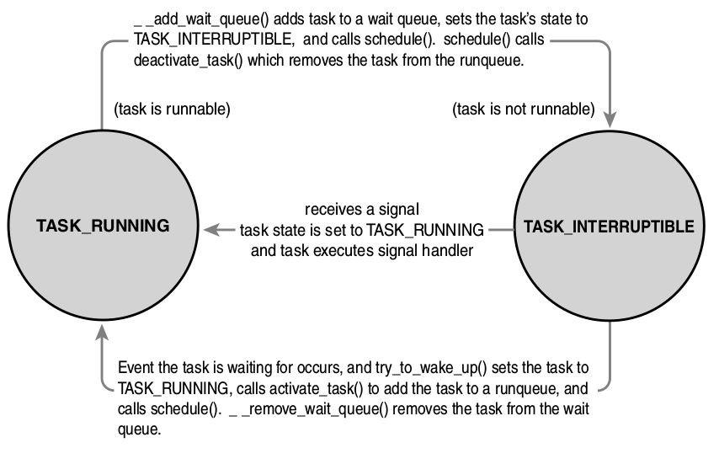
Sleep & Wake up
wake_up() , try_to_wake_up()

Slide 15
try_to_wake_up()
kernel/sched/core.c

Slide 16
Sleep and wakeup
Two problems arise in design of sleep/wakeup

Slide 17
Sleep and wakeup
Two problems arise in design of sleep/wakeup
1. Lost wakeup

Slide 18
Linux Lost Wake-Up Problem
Task A role : if list is empty -> goto sleep
Task B role : insert item to list -> wake up Task A
Task B:
spin_lock(&list_lock);
list_add_tail(&list_head, new_node);
spin_unlock(&list_lock);
wake_up_process(Task A);
Task A:
spin_lock(&list_lock);
if (list_empty(&list_head)) {
spin_unlock(&list_lock);
set_current_state(TASK_INTERRUPTIBLE);
schedule();
spin_lock(&list_lock);
}
/* Rest of the code ... */
spin_unlock(&list_lock);
http://www.linuxjournal.com/article/8144?page=0,2

Slide 19
Linux Lost Wake-Up Problem
Task A role : if list is empty -> goto sleep
Task B role : insert item to list -> wake up Task A
Task B:
spin_lock(&list_lock);
list_add_tail(&list_head, new_node);
spin_unlock(&list_lock);
wake_up_process(Task A); // already running
Task A:
spin_lock(&list_lock);
if (list_empty(&list_head)) {
spin_unlock(&list_lock); //1
set_current_state(TASK_INTERRUPTIBLE); //2
schedule();
spin_lock(&list_lock);
}
/* Rest of the code ... */
spin_unlock(&list_lock);
http://www.linuxjournal.com/article/8144?page=0,2

Slide 20
Lost Wake-Up Solution
Task B:
spin_lock(&list_lock);
list_add_tail(&list_head, new_node);
spin_unlock(&list_lock);
wake_up_process(Task A); // already running
Task A:
set_current_state(TASK_INTERRUPTIBLE);
spin_lock(&list_lock);
if (list_empty(&list_head)) {
spin_unlock(&list_lock);
schedule();
spin_lock(&list_lock);
}
set_current_state(TASK_RUNNING);
/* Rest of the code ... */
spin_unlock(&list_lock);
http://www.linuxjournal.com/article/8144?page=0,2

Slide 21
cpufreq_interactive_speedchange_task()
drivers/cpufreq/cpufreq_interactive.c

Slide 22
Sleeping in the Kernel
Two problems arise in design of sleep/wakeup
1. Lost wakeup
2. Termination running

Slide 23
Termination while running
How does kill(target_pid) work?
Problem: target process may be running
Still using its kernel stack, page table, proc[] entry
might be in a critical section
needs to finish to restore invariants

Slide 24
Termination while running
How does kill(target_pid) work?
Problem: target process may be running
Still using its kernel stack, page table, proc[] entry might be in a critical section, needs to finish to restore invariants
Solution : Linux can't immediately terminate it

Slide 25
Termination while running
Solution:
Linux commits suicide
Sets flag
Target thread checks flag in trap and exits
exit() closes FDs
Yields CPU -> parent process
Problem:
Task’s kernel stack, page table

Slide 26
Termination while sleeping
Solution:
Linux commits suicide
Sets flag
Target thread checks flag in trap and exits
exit() closes FDs
Yields CPU -> parent process
Problem:
Task’s kernel stack, page table
Solution
Sets state to ZOMBIE
Parent wait() frees kernel stack, page table

Slide 27
do_exit()
->exit_notify()
kernel/exit.c

Slide 28
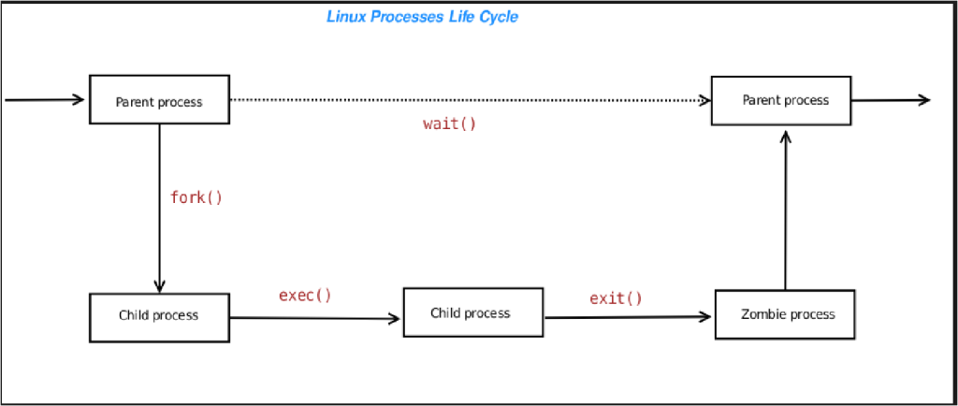
Why defunct(zombie) process are created?
https://amitvashist.wordpress.com/2015/01/01/defunct-processes/

Slide 29
Linux Process States

Slide 30
Scheduling policies in Linux Kernel
The Linux scheduler has been made modular.
SCHED_DEADLINE
SCHED_FIFO
SCHED_RR
SCHED_NORMAL
SCHED_BATCH
SCHED_IDLE

Slide 31
Linux Scheduling Class
Class | Description | Policy
dl_sched_class | real-time task with deadline | SCHED_DEADLINE
rt_sched_class | real-time task | SCHED_FIFO SCHED_RR
fair_sched_class | time-sharing task | SCHED_NORMAL SCHED_BATCH
idle_sched_class | avoid to disturb other tasks | SCHED_IDLE
Scheduler
DL scheduler
RT scheduler
Fair scheduler
Idle scheduler

Slide 32
What is key decision points in the scheduler?

Slide 33
The key decisions
“how to determine a thread’s timeslice? and how to pick the next thread to run”

Slide 34
Timeslice
A time unit allowed for a task at a given time
Affected by timer freq. (HZ)
Hard to optimize
Why?

Slide 35
Timeslice
A time unit allowed for a task at a given time
Affected by timer freq. (HZ)
Hard to optimize since
it should be small for less latency,
but poor throughput : C/W overhead
it should be large for better throughput
poor latency.

Slide 36
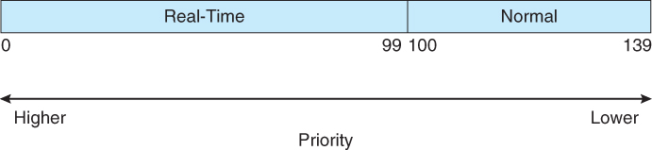
Nice Values and Task Priority
Non-real-time priority
Nice value (-20~19, default 0)
A large nice value corresponds to a lower priority
Real-time priority
Priority range: 0~99
Priority for real-time tasks
SCHED_FIFO, SCHED_RR
A smaller value corresponds to a higher priority
https://www2.cs.uic.edu/~jbell/CourseNotes/OperatingSystems/6_CPU_Scheduling.html

Slide 37
Functions in Scheduling Class
enqueue_task
put the task into the run queue
increment the nr_running variable
dequeue_task
remove the task from the run queue
decrement the nr_running variable
yield_task
relinquish the CPU
check_preempt_curr
check whether the currently running task can be preempted by a new task
pick_next_task
choose the most appropriated task
load_balance
trigger load balancing code

Slide 38
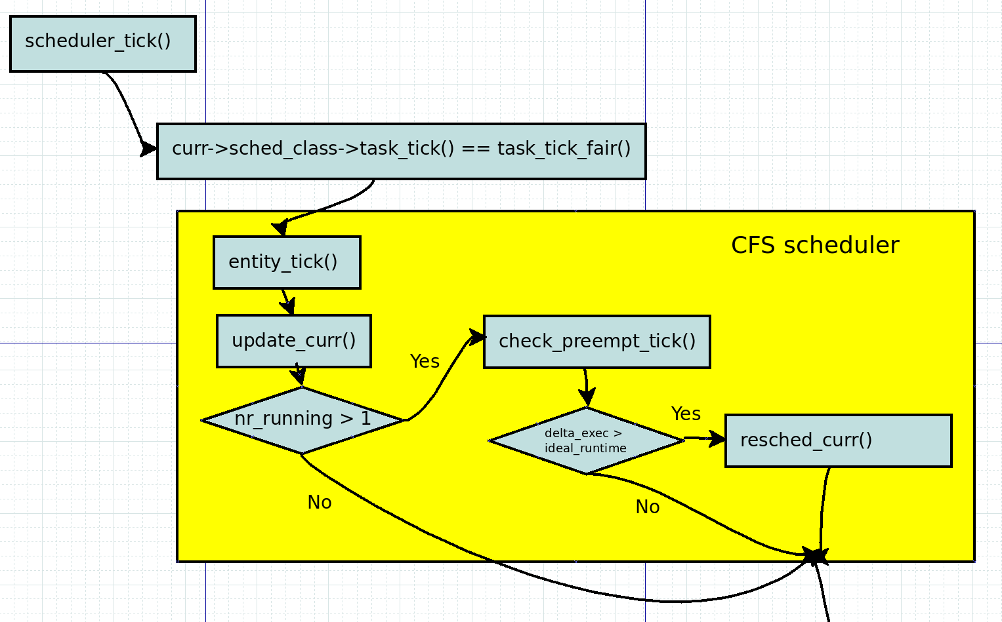
When schedule a task
Periodically forces a switch
Scheduler Tick

Slide 39
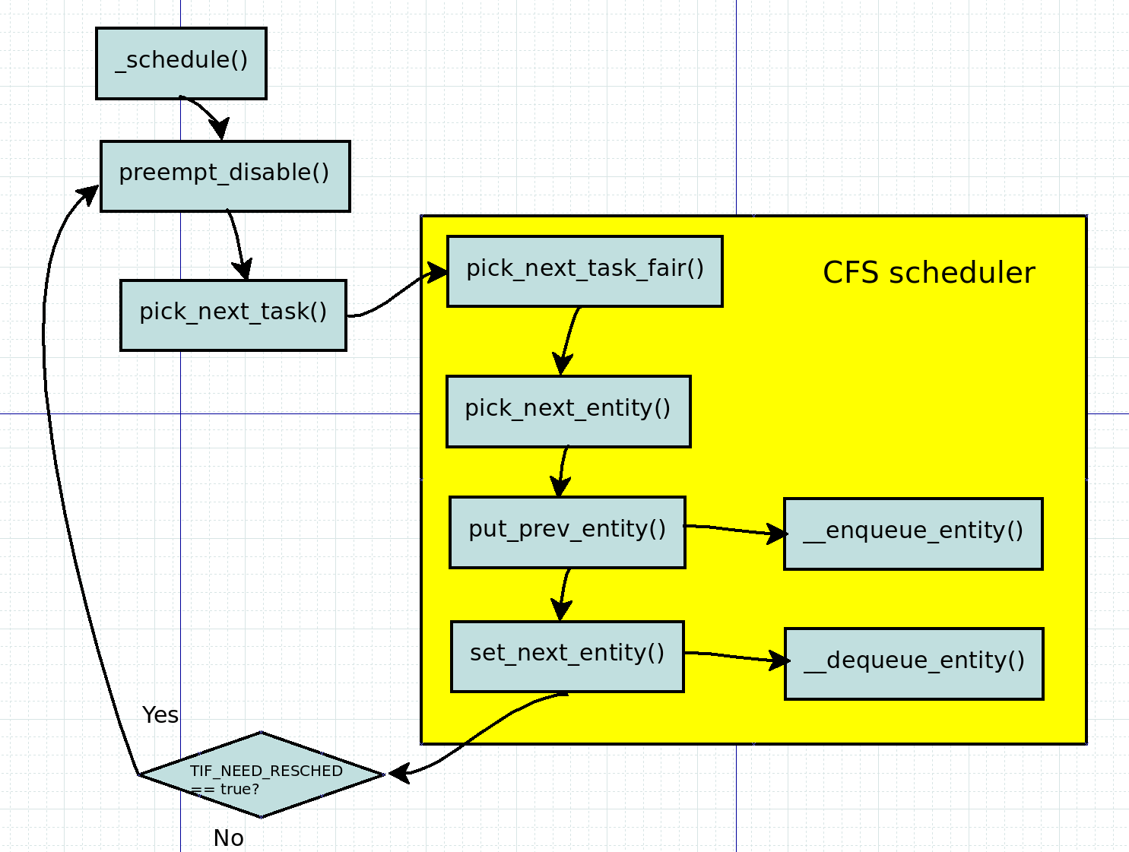
Scheduling by schedule()
TIF_NEED_RESCHED
Sleep and wakeup - I/O wait, pipe, system call

Slide 40
__schedule()
kernel/sched/core.c
static void __sched __schedule(void) {
...
need_resched:
preempt_disable();
cpu = smp_processor_id();
//Save current task as prev
rq = cpu_rq(cpu);
prev = rq->curr;
...
next = pick_next_task(rq, prev);
//Enqueue and dequeue tasks
...
if (need_resched())
Check TIF_NEED_RESCHED
goto need_resched;
}

Slide 41
__schedule()
kernel/sched/core.c

Slide 42
Multi-core & Load balancer

Slide 43
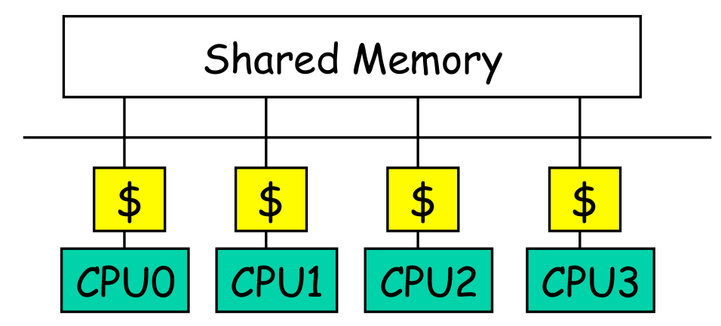
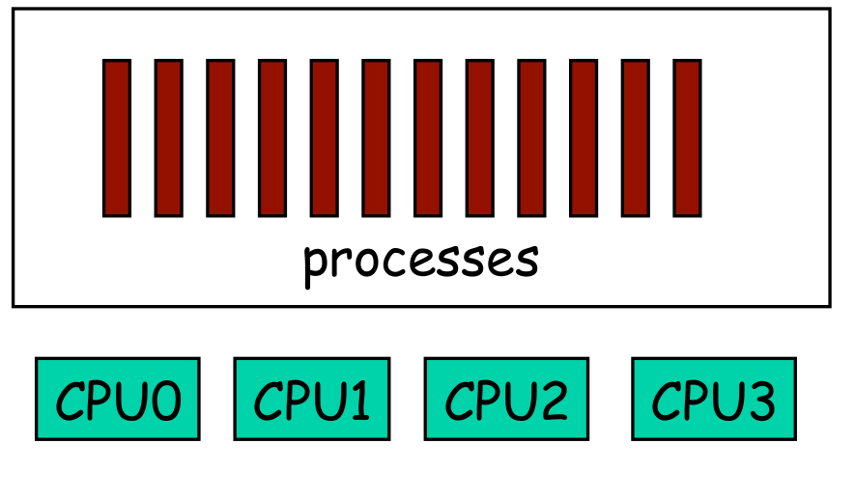
Multiprocessor scheduling
Shared-memory Multiprocessor
How to allocate processes to CPU?

Slide 44
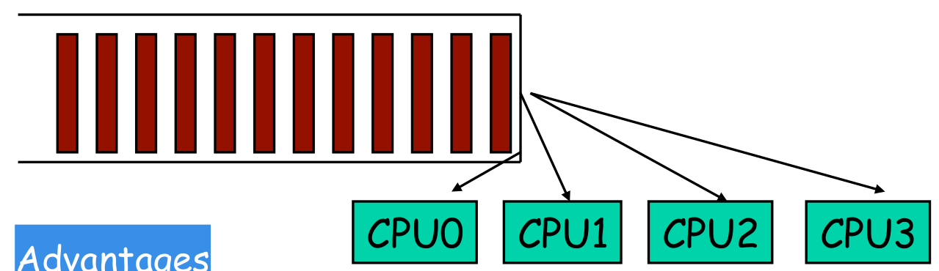
Global queue of processes
One ready queue shared across all CPUs
Advantages

Slide 45
Global queue of processes
One ready queue shared across all CPUs
Advantages
Good CPU utilization
Fair to all processes
Disadvantages

Slide 46
Global queue of processes
One ready queue shared across all CPUs
Advantages
Good CPU utilization
Fair to all processes
Disadvantages
Not scalable (contention for global lock)
Poor cache locality
Linux 2.4 uses global queue

Slide 47
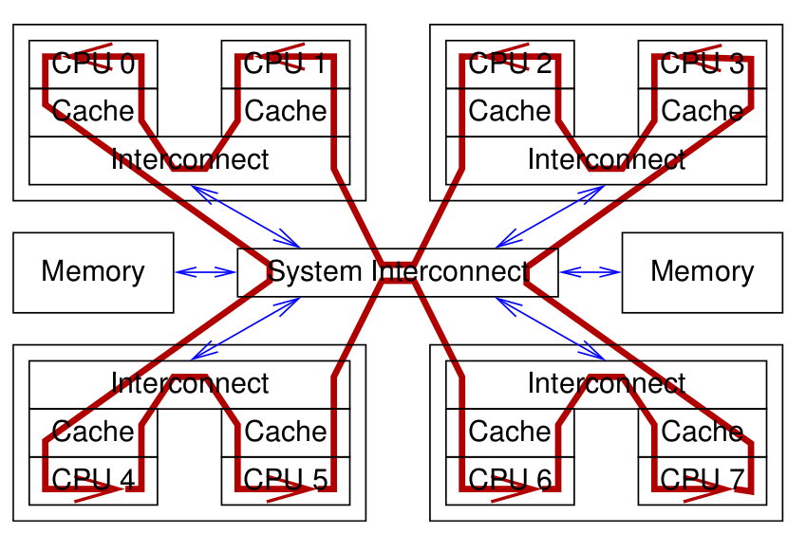
Global queue of processes

Slide 48
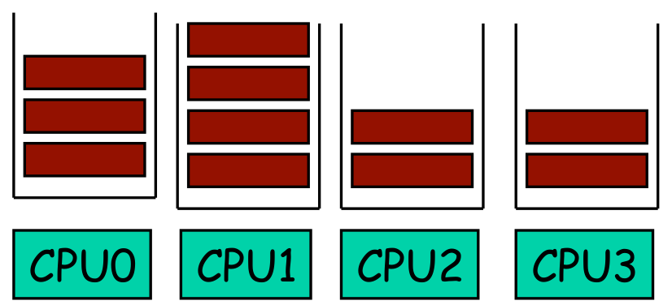
Per-CPU queue of processes
Static partition of processes to CPUs
Advantages

Slide 49
Per-CPU queue of processes
Static partition of processes to CPUs
Advantages
Easy to implement
Scalable (no contention on ready queue)
Better cache locality
Disadvantages

Slide 50
Per-CPU queue of processes
Static partition of processes to CPUs
Advantages
Easy to implement
Scalable (no contention on ready queue)
Better cache locality
Disadvantages
Load-imbalance (some CPUs have more processes)

Slide 51
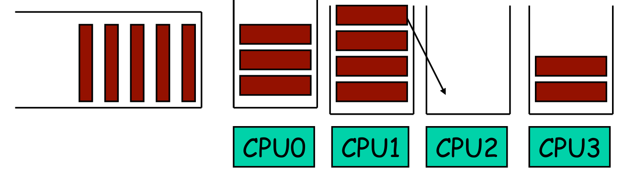
Hybrid approach
Use both global and per-CPU queues
Balance jobs across queues
Processor Affinity
Add process to a CPU’s queue if recently run on the CPU
Cache state may still present
Linux 2.6 uses a very similar approach

Slide 52
load_balance()
select_task_rq()
kernel/sched/core.c

Slide 53
Chances to balance
fork & exec
spread to any idlest cpu
wake up
keep prev cpu or migrate to current cpu or its idle sibling
idle
migrate to current cpu
periodic
migrate to current cpu (or its siblings)

Slide 54

Next Step.
Energy-aware scheduling: EAS
CFS scheduler - Kernel level
Load Balancer(Group Scheduling, Bandwidth Control, PELT)
EAS features

Slide 55
Reference
https://pdos.csail.mit.edu/6.828/2016/schedule.html
http://web.mit.edu/6.033
http://www.rdrop.com/~paulmck/
“Is Parallel Programming Hard, And If So, What Can You Do About It?”
Davidlohr Bueso. 2014. Scalability techniques for practical synchronization primitives. Commun. ACM 58
http://queue.acm.org/detail.cfm?id=2698990
"CPUFreq and The Scheduler Revolution in CPU Power Management", Rafael J. Wysocki
https://sites.google.com/site/embedwiki/oses/linux/pm/pm-qos
https://intl.aliyun.com/forum/read-916
User-level threads : co-routines
http://www.gamedevforever.com/291
https://www.youtube.com/watch?v=YYtzQ355_Co
Scheduler Activations
https://cgi.cse.unsw.edu.au/~cs3231/12s1/lectures/SchedulerActivations.pdf
https://en.wikipedia.org/wiki/FIFO_(computing_and_electronics)
http://jake.dothome.co.kr/
http://www.linuxjournal.com/magazine/completely-fair-scheduler?page=0,0
https://www2.cs.uic.edu/~jbell/CourseNotes/OperatingSystems/6_CPU_Scheduling.html
"Energy Aware Scheduling", Byungchul Park, LG Electronic
“Update on big.LITTLE scheduling experiments”, ARM
“EAS Update” 2015 september ARM
"EAS Overview and Integration Guide”, ARM TR
“Drowsy Power Management”, Matthew Lentz, SOSP 2015
https://www.slideshare.net/nanik/learning-aosp-android-hardware-abstraction-layer-hal
https://www.youtube.com/watch?v=oTGQXqD3CNI
https://www.youtube.com/watch?v=P80NcKUKpuo
https://lwn.net/Articles/398470/
“SCHED_DEADLINE: It’s Alive!”, ARM, 2017

